Slide 1

EXECUTIVE SUMMARY
Airline Safety Analysis: ABC Airlines
Kausik Chattapadhyay

Slide 2




Comparison - Other Means of Travel
Airplane is the 6th most used mode of transportation whereas car is at the 2nd place.
Average auto fatality is 129 times more than average annual due to airlines.
Between the 1985-1999 and 2000-2014, decreasing trend in total fatality in both cases.
42000
324
Number of average annual fatalities based on data from 1985-2014
US data
Global data
Total number of fatality in the analyzed timeframe(s)
6,44,307
5,76,546
1,941
1,114
1985
2000
2014
1985
2000
2014

Slide 3

Technology – Does It Play Any Role?
Overall fatality and incident both reduced over time.
Consistently lower in economically and technically advanced countries.
Between 1985-1999, airlines fatalities was 6.7 times more in countries other than the first world countries
Between 2000-2014, airlines fatalities was 9 times more in countries other than the first world countries
.
Between 1985-1999, airlines incidents was 6.14 times more in countries other than the first world countries
Between 2000-2014, airlines incidents was 3.3 times more in countries other than the first world countries
.

Slide 4





Correlation – Is There Any?
Fatalities
Avianca had a series of major accidents in the first timeframe (1985-1999) but none after that.
Kenya Airways had diametrically opposite stats between the timeframes.
China Airlines had fatalities in both timeframes.
Incidents
Most airlines showed signs of improvement in incident rates.
Outliers such as PIA and Ethiopian Airlines remained with persistently high rates of incidents.
Top 5 Airlines with overall most incidents between 1985-2014

Slide 5
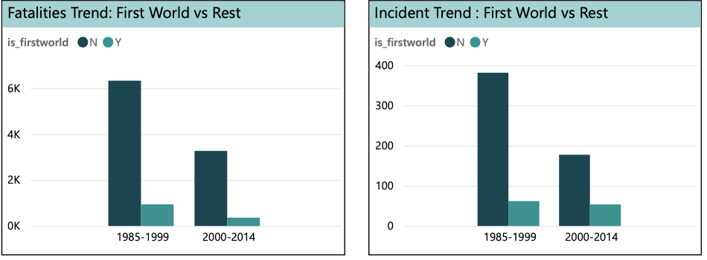
Ethical Consideration
Accuracy and Truthfulness
Transparency:
Contextualization
Responsible Data Visualization
Sensitivity to Victims and Their Families
Consistency and Long-Term Focus
Openness to Feedback and Improvement
7/1/23

Slide 6
Conclusion
The past record of specific airlines can provide insights into future accident chances if analyzed correctly.
Flight incidents and fatalities are decreasing over time due to advancements in technology.
First world countries have historically experienced fewer flight incidents compared to other regions, possibly due to technological advancements.
Comparative analysis of worldwide air travel incidents and road safety incidents in the USA demonstrates that airlines are exceptionally safe.
Claims that air travel is no longer safe may result from oversampled data that is biased by geography, timeframe, or specific airlines.
While no mode of travel can guarantee complete prevention of disasters, statistics show that air travel remains one of the safest means of transportation.

Slide 7
THANK YOU

